Slide 1


POST GRADUATE PROGRAM IN DATA SCIENCE & BUSINESS ANALYTICS
CAPSTONE PROJECT
Submitted By:
STEFFIN JOHN
VIJAYAPRABAKARAN L
Group -07
CASE STUDIES ON:
Customer Churn Prediction Analysis

Slide 2
CASE STUDY

Slide 3
An E Commerce company or DTH (you can choose either of these two domains) provider is facing a lot of competition in the current market and it has become a challenge to retain the existing customers in the current situation. Hence, the company wants to develop a model through which they can do churn prediction of the accounts and provide segmented offers to the potential churners. In this company, account churn is a major thing because 1 account can have multiple customers. hence by losing one account the company might be losing more than one customer.
You have been assigned to develop a churn prediction model for this company and provide business recommendations on the campaign.
Your campaign suggestion should be unique and be very clear on the campaign offer because your recommendation will go through the revenue assurance team. If they find that you are giving a lot of free (or subsidized) stuff thereby making a loss to the company; they are not going to approve your recommendation. Hence be very careful while providing campaign recommendation.

Slide 4
DATA DICTIONARY
Variable | Description
AccountID | account unique identifier
Churn | account churn flag (Target) 0= Not churned, 1 = Churned
Tenure | Tenure of account
City_Tier | Tier of primary customer's city
CC_Contacted_L12m | How many times all the customers of the account has contacted customer care in last 12months
Payment | Preferred Payment mode of the customers in the account
Gender | Gender of the primary customer of the account
Service_Score | Satisfaction score given by customers of the account on service provided by company
Account_user_count | Number of customers tagged with this account
account_segment | Account segmentation on the basis of spend
CC_Agent_Score | Satisfaction score given by Agents of the account on customer care service provided by company
Marital_Status | Marital status of the primary customer of the account
rev_per_month | Monthly average revenue generated by account in last 12 months
Complain_l12m | Any complaints has been raised by account in last 12 months
rev_growth_yoy | revenue growth percentage of the account (last 12 months vs last 24 to 13 month)
coupon_used_l12m | How many times customers have used coupons to do the payment in last 12 months
Day_Since_CC_connect | Number of days since no customers in the account has contacted the customer care
cashback_l12m | Monthly average cashback generated by account in last 12 months
Login_device | Preferred login device of the customers in the account
Noise Index | Formula = CC_Contacted_LY/Tenure # noise_index <= 1 in a month : Low noise # noise_index <=100 in a month : medium noise # noise_index > 100 in a month : high noise
cashback_percen | Formula = rev_per_month * 12/cashback # cashback_percen <= 0.5 : Low discount # cashback_percen <=1 : medium discount # cashback_percen > 1 : high discount
Cashback_Benefits | Formula = Cashback/Tenure These are the benefits received as long as customer stay with the company. If the value the very high customer has received a lot of benefits from company and check % of churned customers Low Benefit ,medium benefit and High Benefit

Slide 5
WHY REDUCTION OF CUSTOMER CHURN IMPORTANT ?
Harvard Business Review, a 5% increase in customer retention can lead to an increase in profits of between 25% to 95%
A report by Epsilon found that customers who make repeat purchases spend 67% more than new customers.
Affects a Company’s Revenue
Acquisition Costs
Build Customer Loyalty
Company’s Reputation

Slide 6
EXPLORATORY DATA ANALYSIS INSIGHTS

Slide 7
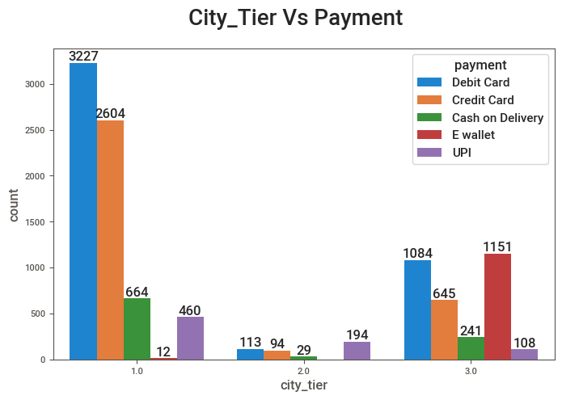

Slide 8
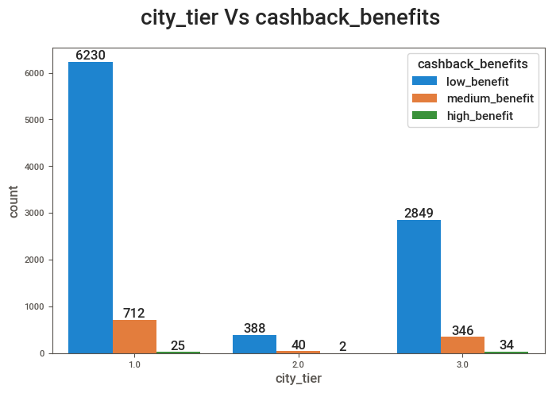

Slide 9
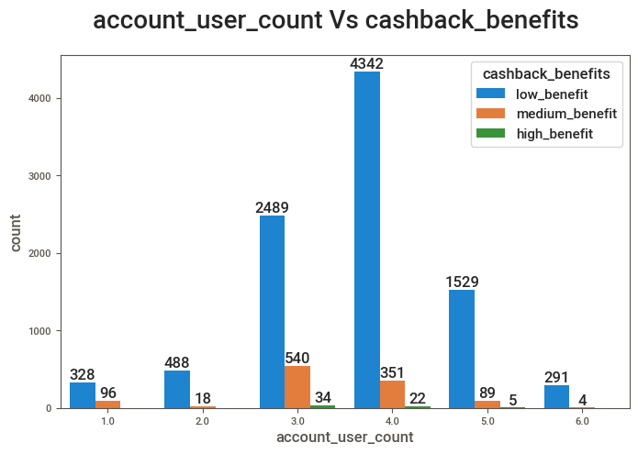

Slide 10
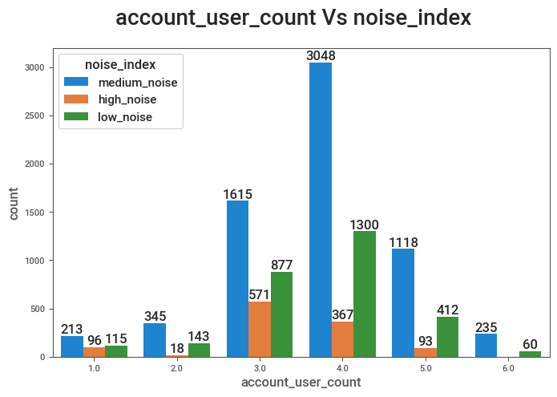

Slide 11
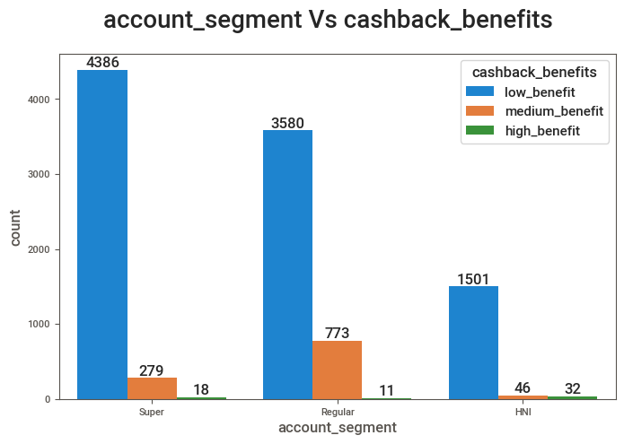

Slide 12
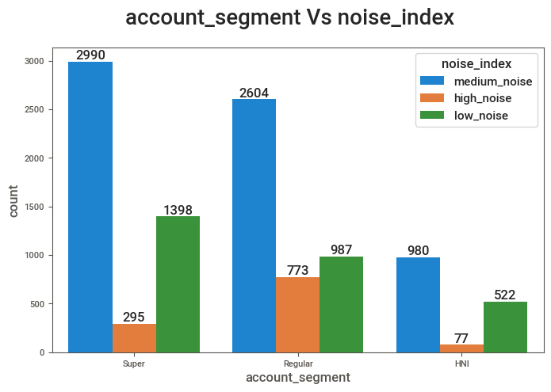

Slide 13
STATISTICAL ANALYSIS
(T-test, ANOVA, Chi-Square Test)

Slide 14
Variable | Results of T-test, ANOVA and Chi-Square Test
Tenure | Their is a relationship between churn and tenure.
City_Tier | Their is a relationship between churn and city_tier.
CC_Contacted_L12m | Their is a relationship between churn and cc_contacted_ly.
Payment | Their is a relationship between churn and payment.
Gender | Their is a relationship between churn and gender.
Service_Score | Their is a relationship between churn and service_score.
Account_user_count | Their is a relationship between churn and account_user_count.
account_segment | Their is a relationship between churn and account_segment.
CC_Agent_Score | Their is a relationship between churn and cc_agent_score.
Marital_Status | Their is a relationship between churn and marital_status.
rev_per_month | Their is no relationship between churn and rev_per_month
Complain_l12m | Their is a relationship between churn and complain_ly.
rev_growth_yoy | Their is no relationship between churn and rev_growth_yoy
coupon_used_l12m | Their is no relationship between churn and coupon_used_for_payment.
Day_Since_CC_connect | Their is a relationship between churn and day_since_cc_connect.
cashback_l12m | Their is a relationship between churn and cashback.
Login_device | Their is a relationship between churn and login_device.
Noise Index | Their is a relationship between churn and noise_index.
cashback_percen | Their is a relationship between churn and cashback_percen.
Cashback_Benefits | Their is a relationship between churn and cashback_benefits.

Slide 15
CHURN ANALYSIS (Impact of Churn)

Slide 16
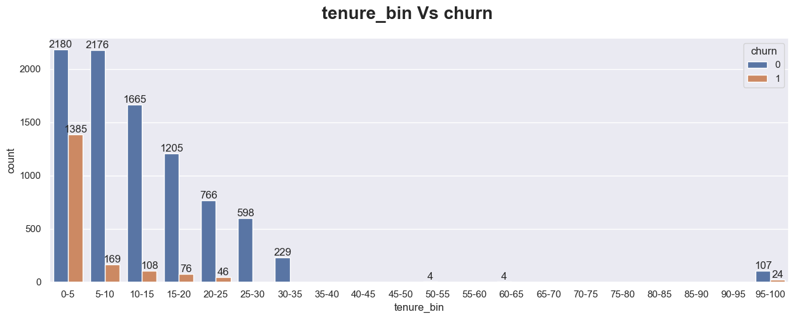

Slide 17
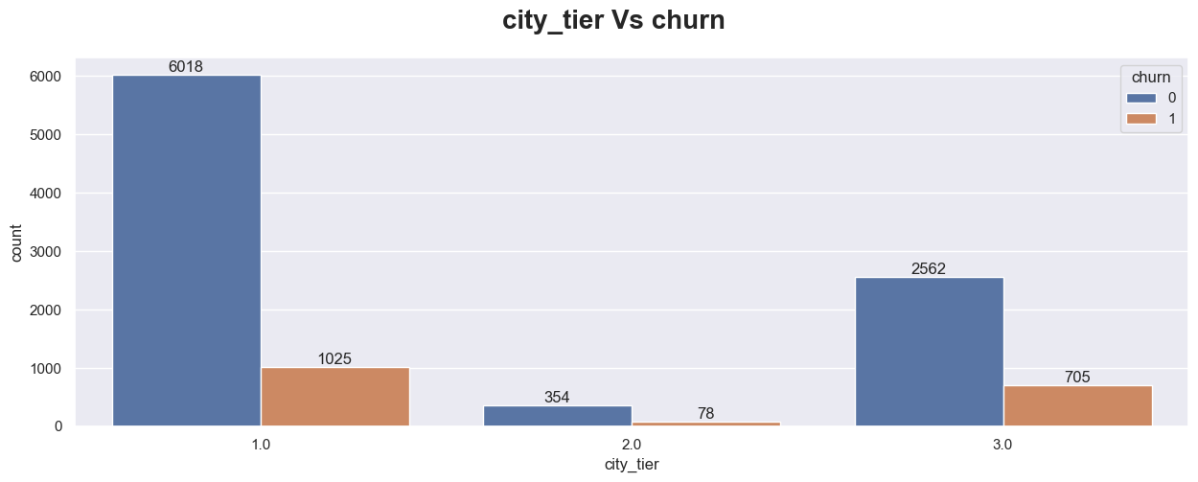
Churn Rate: Tier 1 = 15% Tier 2 = 18% Tier 3 = 22%

Slide 18
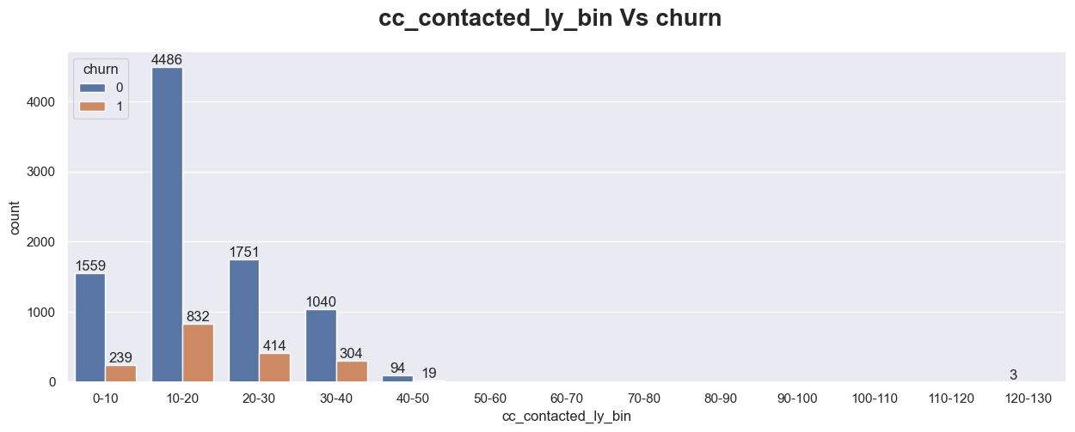
Churn Rate:
0-10 = 13% 10-20 = 15% 20-30 = 19% 30-40 - 22% 40-50 - 15%

Slide 19
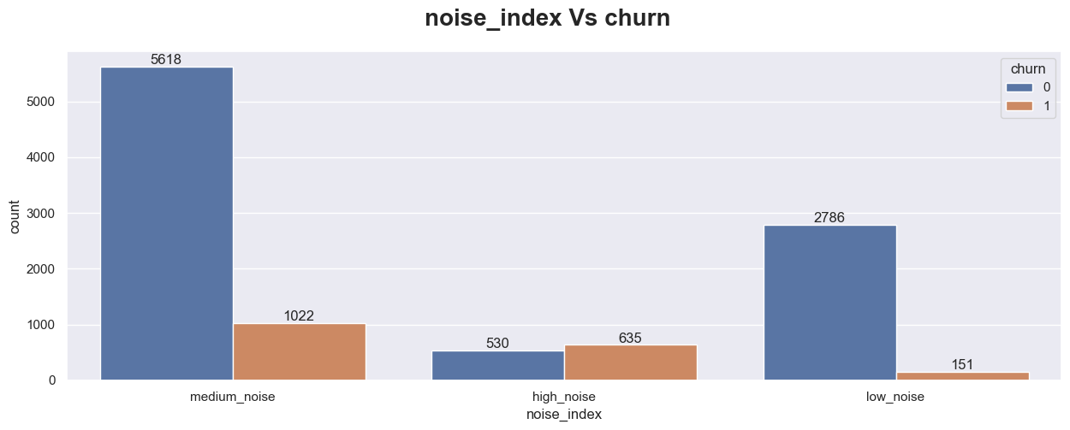
Churn Rate: Low Noise = 5% Medium Noise = 15% High Noise = 54%

Slide 20
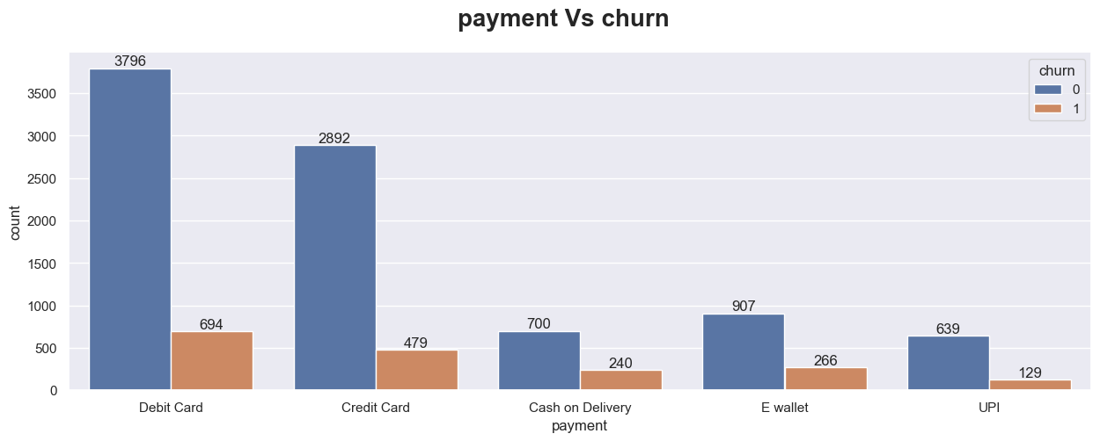
Churn Rate:
Debit Card: 15% Credit Card: 14% COD: 25% E-wallet: 22% UPI: 17%

Slide 21
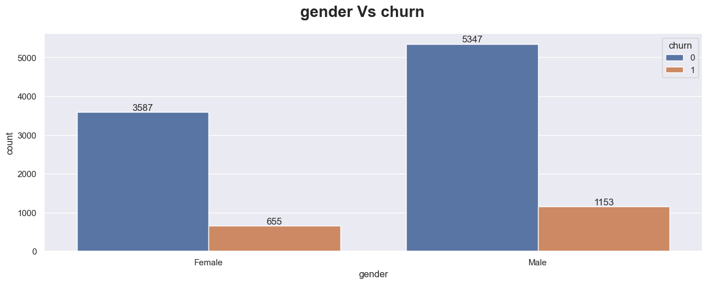
Churn Rate : Female = 15% Male = 17%

Slide 22
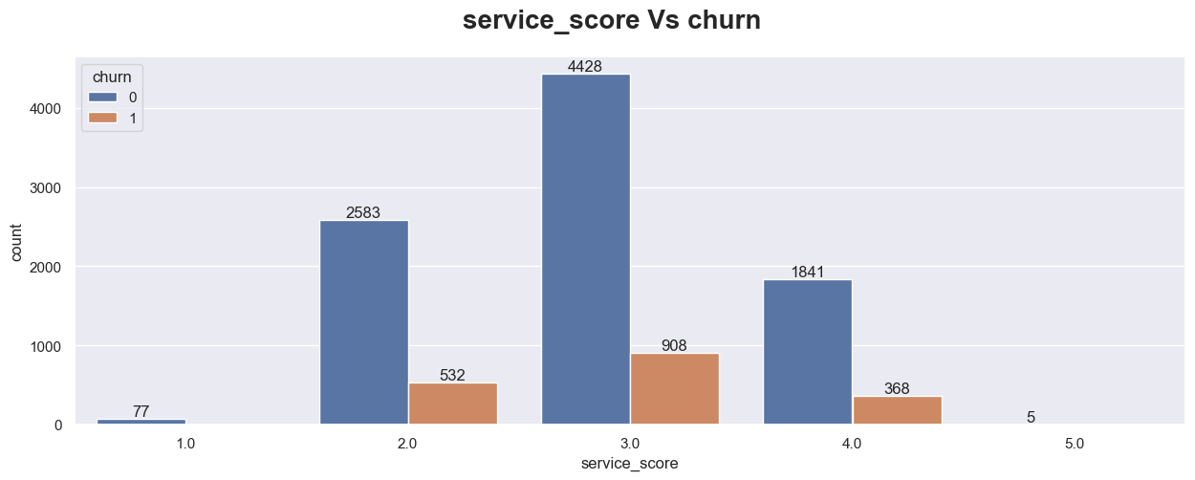
Churn Rate:
SS 1 = 0% SS 2 = 16% SS 3 = 17% SS 4 = 16% SS 5 = 0%

Slide 23
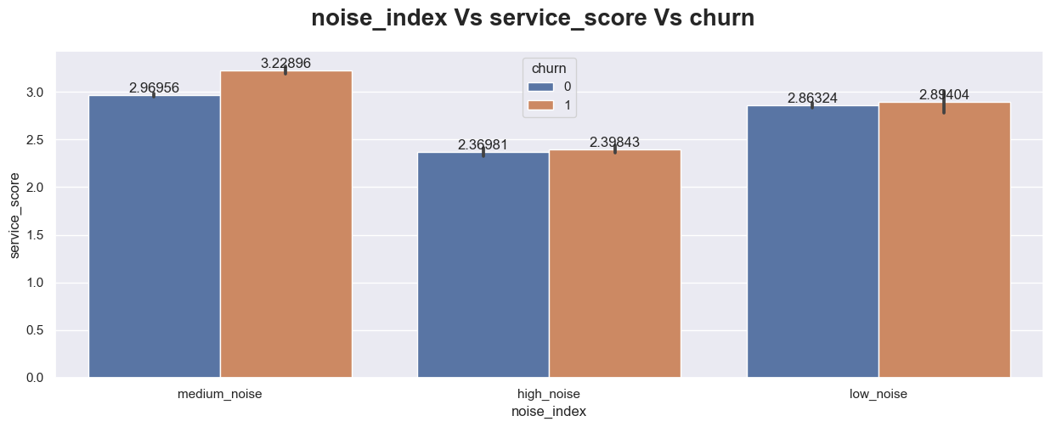

Slide 24
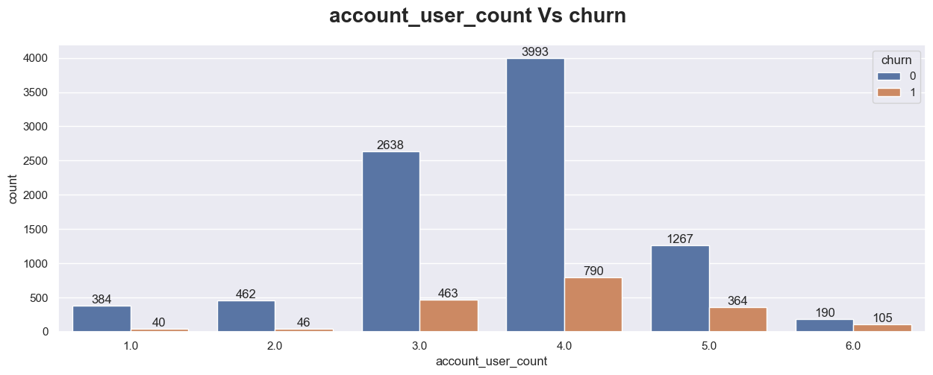
Churn Rate:
AUC 1 = 9% AUC 2 = 9% AUC 3 = 15% AUC 4 = 16% AUC 5 = 22% AUC 6 = 34%

Slide 25
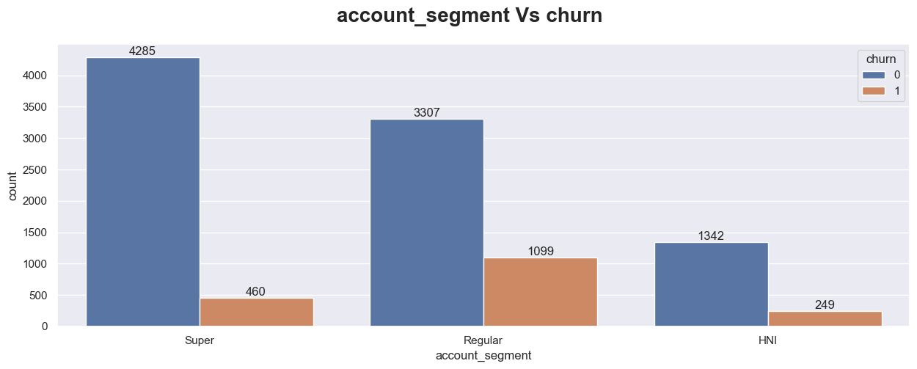
Churn Rate: Regular = 25% Super = 9% HNI = 16%

Slide 26
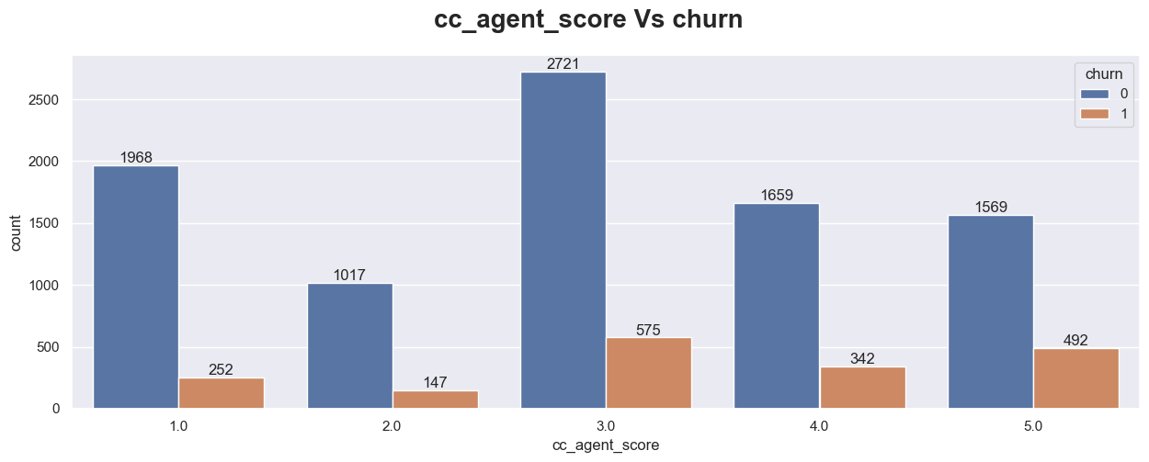
Churn Rate:
CAS 1 = 11% CAS 2 = 13% CAS 3 = 17% CAS 4 = 17% CAS 5 = 24%

Slide 27
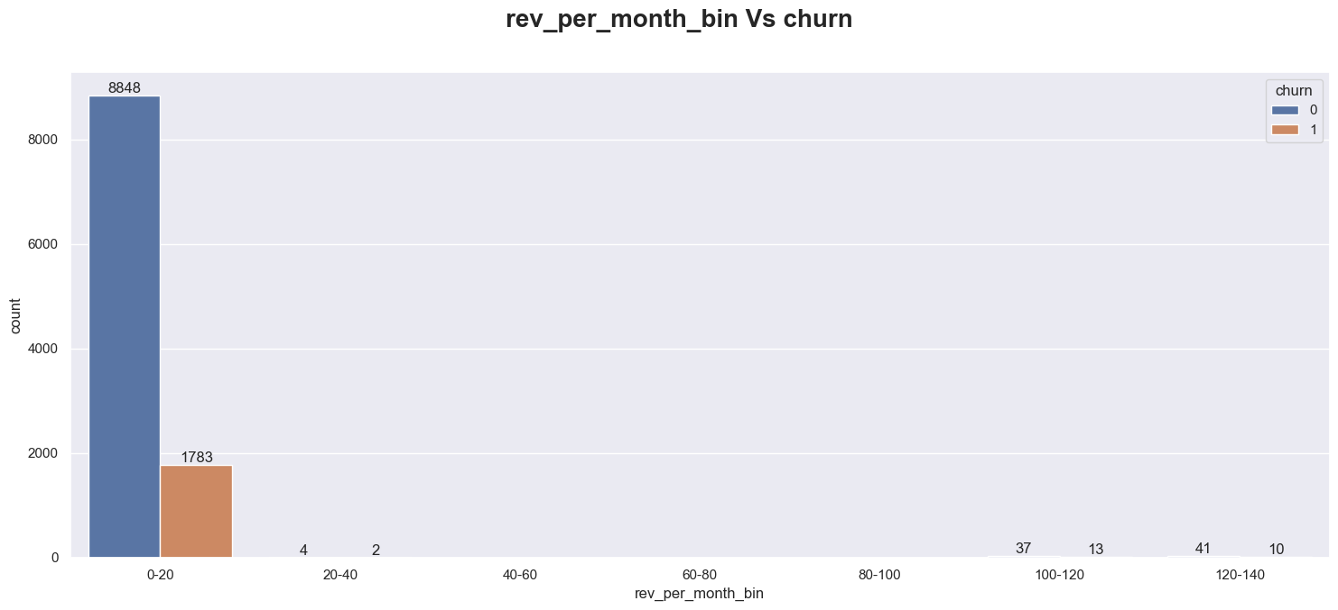

Slide 28
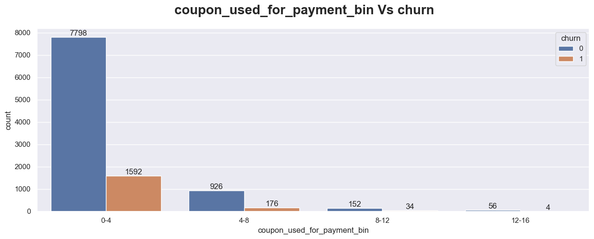
Churn Rate:
0-4 = 17% 4-8 = 16% 8-12 = 18% 12-16 = 6%

Slide 29
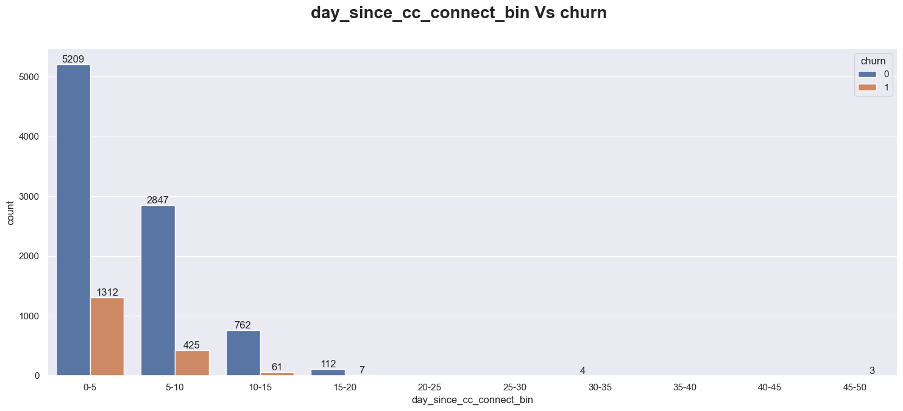

Slide 30
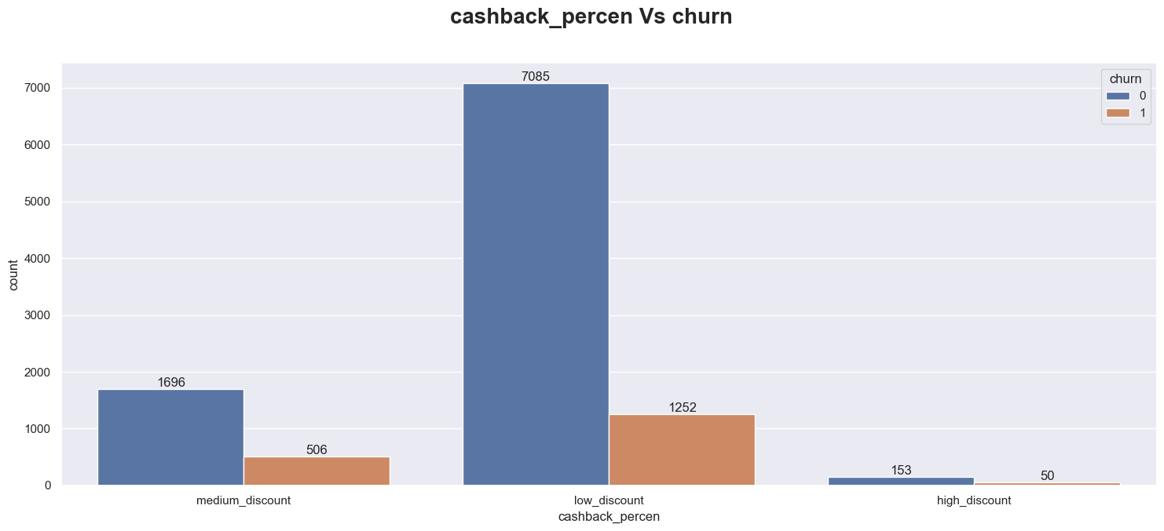
Churn Rate:
Medium Discount = 23% Low Discount = 15% High Discount = 25%

Slide 31
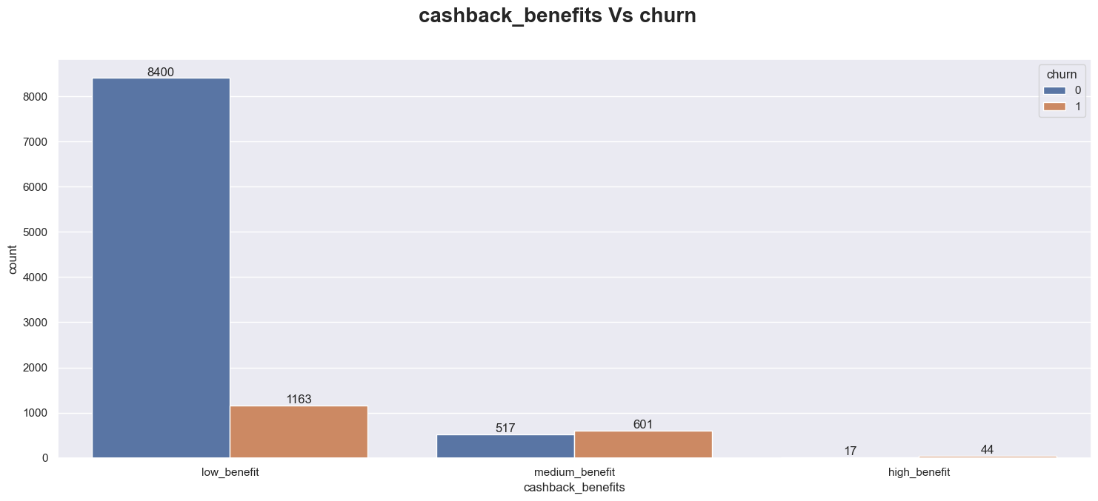
Churn Rate:
Low Benefit = 12% Medium Benefit = 53% High Benefit = 75%

Slide 32
Model Building

Slide 33
BASE MODEL
Logistic regression
COMPARISION MODELS
Logistic Regression
KNN
Bagging
XGBoost
Support Vector Machine
Naïve Bayes
Decision Tree
Extra Trees Classifier
Linear Discriminant Analysis

Slide 34
Model Building
(BASE MODEL)

Slide 35
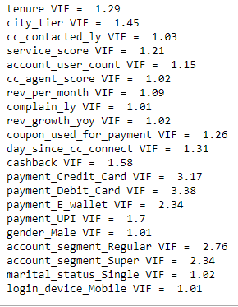
Variance Inflation Factor (VIF)
A rule of thumb for interpreting the variance inflation factor:
* 1 = not correlated.
* Between 1 and 5 = moderately correlated.
* Greater than 5 = highly correlated.

Slide 36
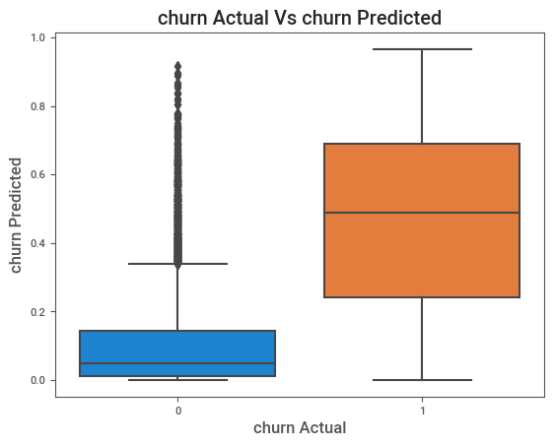
Spread of the probability of Churn Column : Cut-off = 0.5

Slide 37
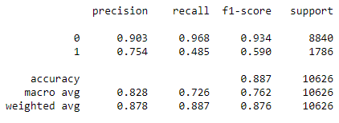
Classification Report
Accuracy = 88.7 %
precision = 75.4 %
recall = 48.5 %
f1-score = 59 %

Slide 38
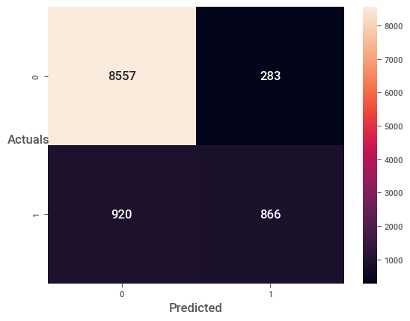

Confusion Matrix

Slide 39
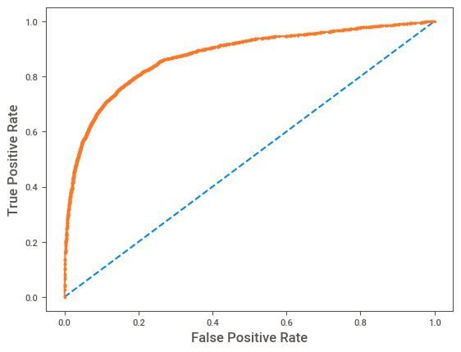
AUC – ROC Curve
LR model with an AUC of 0.87 is considered to have a good discriminatory power, between the positive and negative classes.

Slide 40
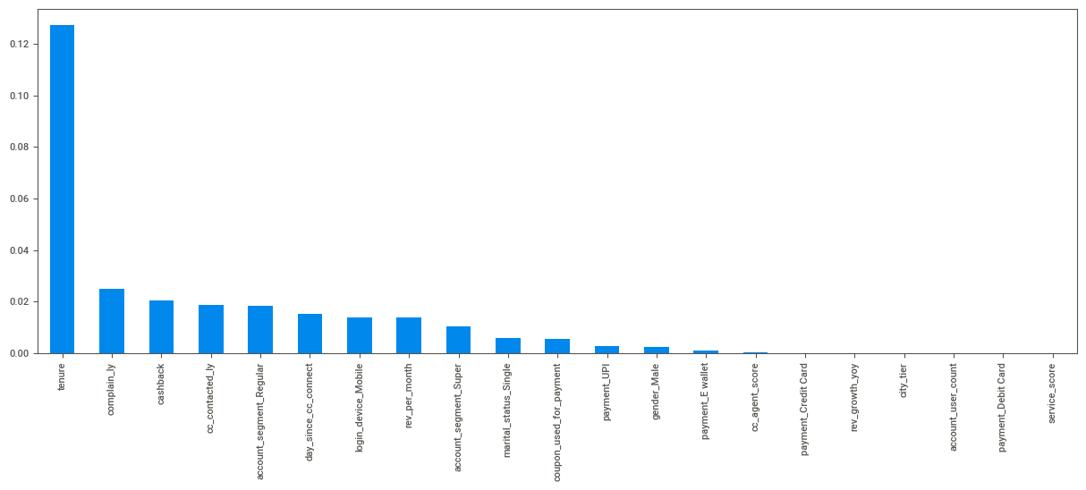
Feature Selection - Information Gain

Slide 41
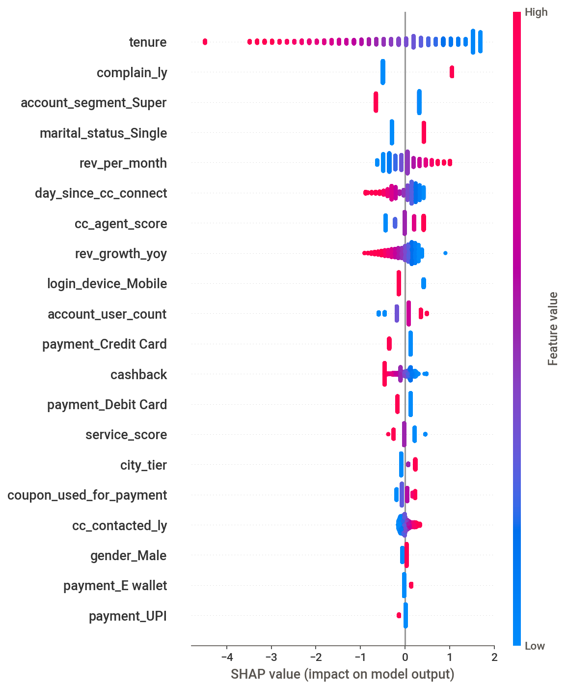
SHAP (SHapley Additive exPlanations) Values
Explain the output of machine learning models
SHAP values explain the contribution of each feature to the prediction made by the model.
SHAP plot, which displays the impact of each feature on the prediction for a particular data point.

Slide 42
Model Building
(COMPARISION MODEL)

Slide 43
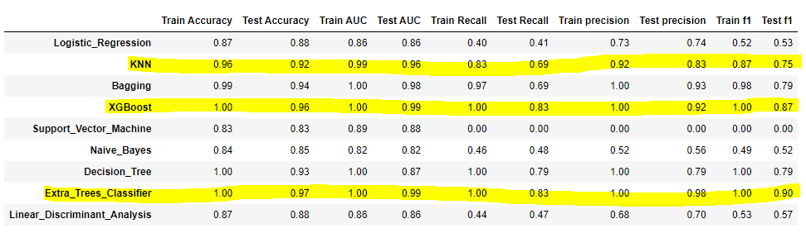
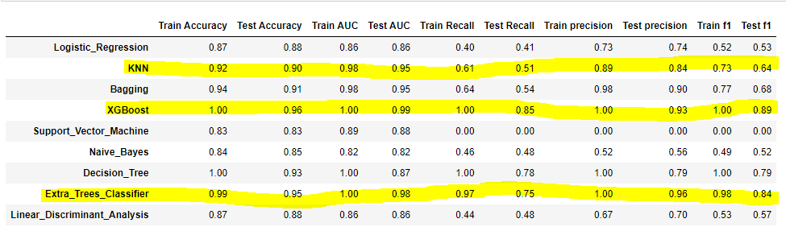
9 ML Models –
Untuned
9 ML Models –
Tuned

Slide 44
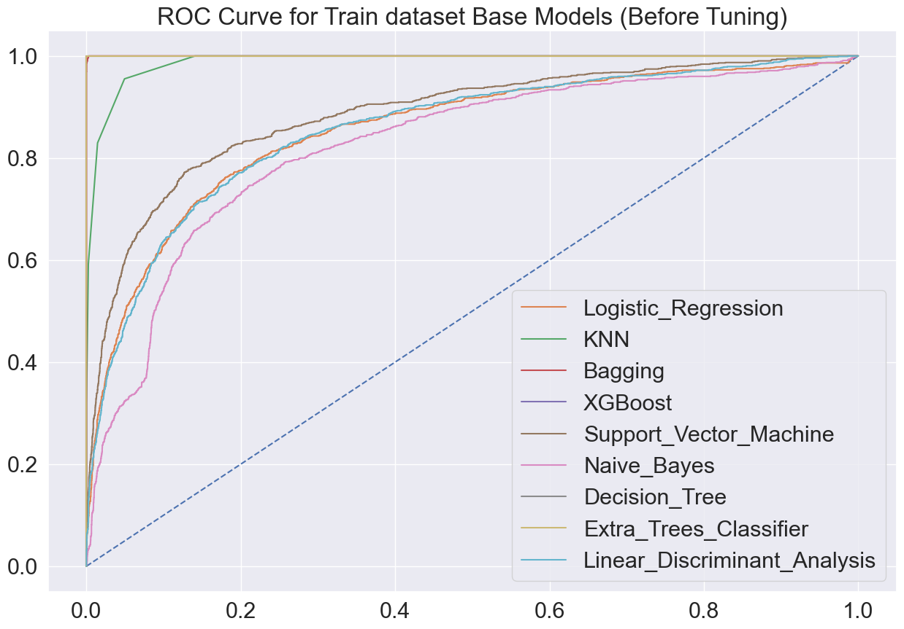
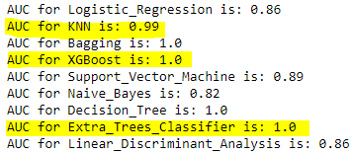

Slide 45
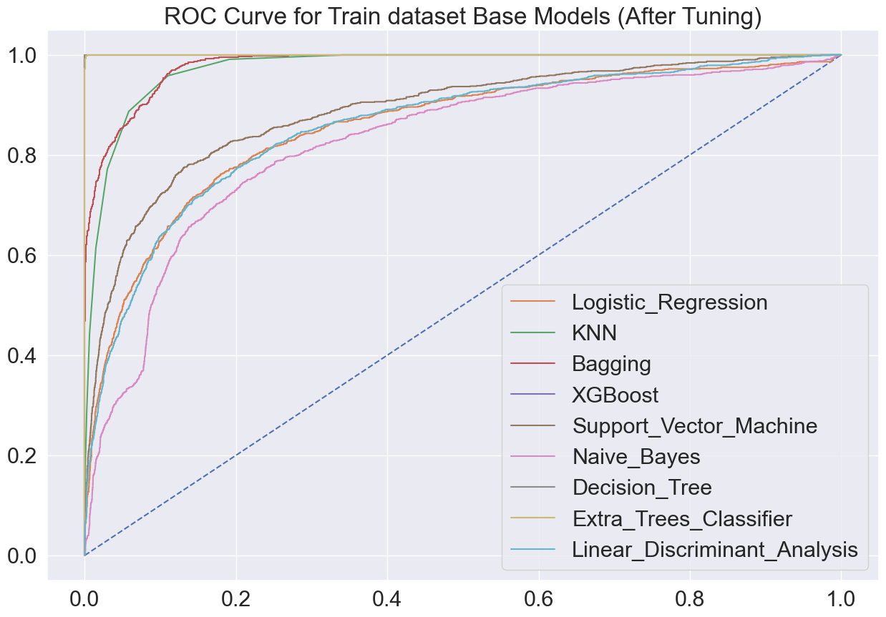
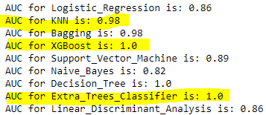

Slide 46

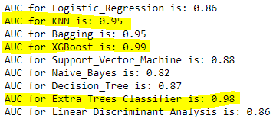

Slide 47
Model Building
(COMPARISION MODEL
+
SMOTE)

Slide 48
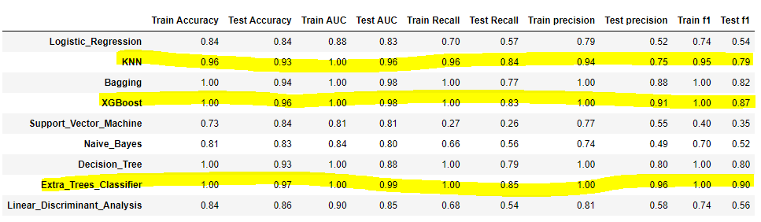
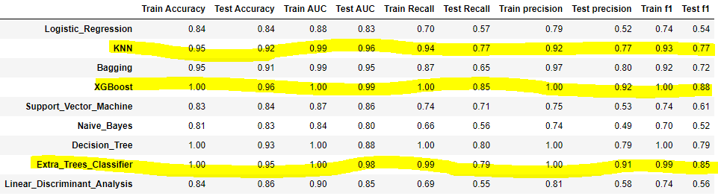
9 ML Models –
Untuned
+
SMOTE
9 ML Models –
Tuned
+
SMOTE

Slide 49
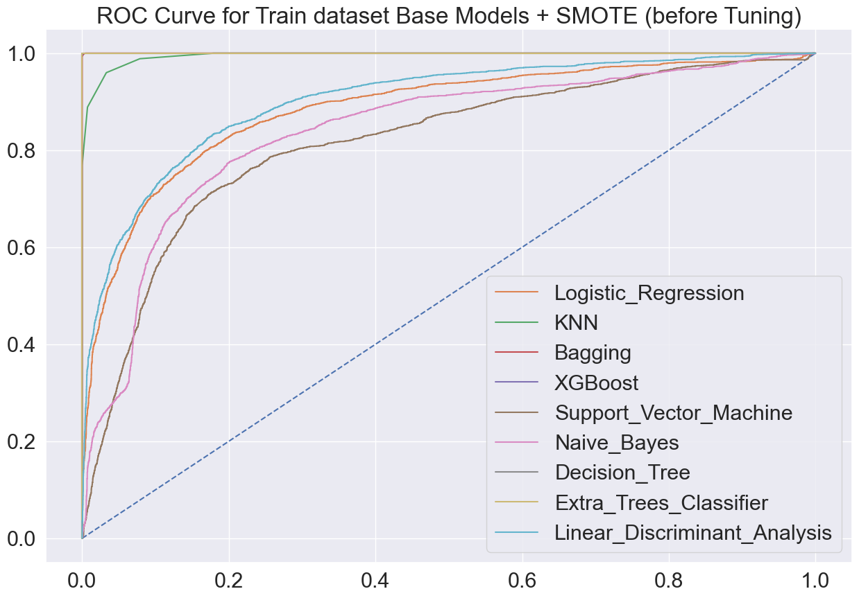
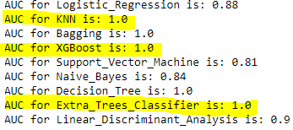

Slide 50
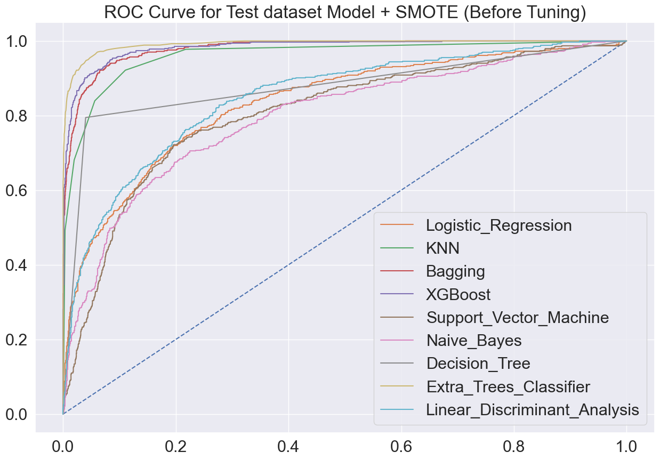
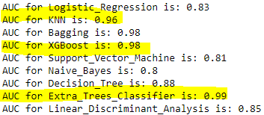

Slide 51
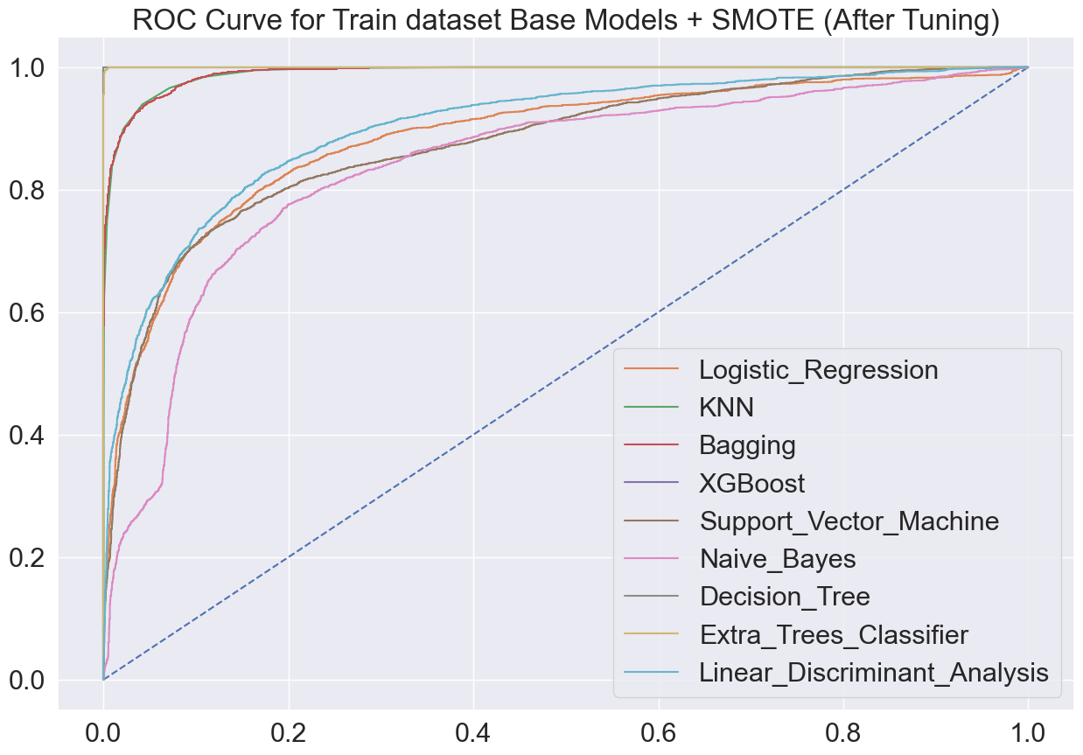
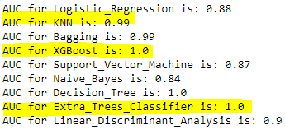

Slide 52

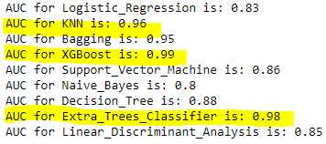

Slide 53
Final Model – Extra Tree Classifier
Advantages of using Extra Tree Classifier over some of the other algorithms you listed:
Better at handling noisy data: Extra Tree Classifier randomly selects features and splits in the training data, which makes it more robust to noisy data
2) Faster training time: Extra Tree Classifier builds multiple decision trees with random splits, which makes it faster to train compared to algorithms like SVM and KNN that require more computational resources.
3) Less prone to overfitting: Extra Tree Classifier randomly selects features and splits, which helps to reduce overfitting compared to algorithms like Decision Trees.

Slide 54
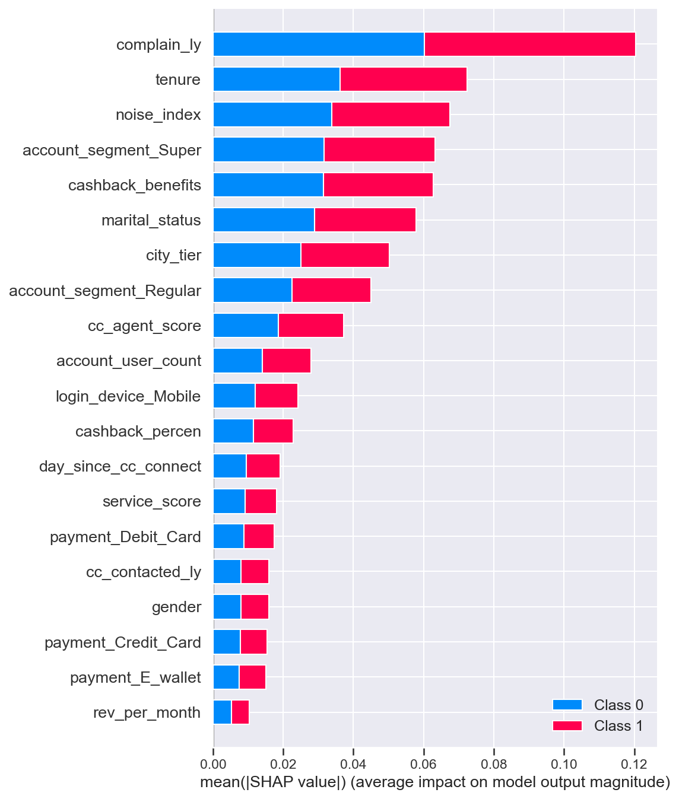
SHAP Values – Extra Tree Classifier
Complain_ly
Noise Index
Account Segment
Cashback benefits
Marital Status
City tier
Cc_agent score
Account User count

Slide 55
The company has a high overall churn rate and needs to take steps to address this issue, such as improving customer service or product offerings.
• Customers who have been with the company for less than six months are churning at a high rate, indicating a need to focus on improving retention in the early stages of the customer journey.
• Customers in Tier-3 cities are churning at a higher rate than those in Tier-1 or Tier-2 cities, suggesting the need for targeted marketing and customer engagement strategies in these areas.
• The company needs to pay attention to the number of customer service calls received, as customers who call frequently (i.e. have a high "noise index") are churning at a high rate.
• Cash on delivery is the payment method with the highest churn rate, indicating a need to explore alternative payment options or improve the cash on delivery experience for customers.
• Male customers are churning at a higher rate than female customers, suggesting the need for targeted marketing and retention strategies for male customers.
• Customers with a service score of 3 are churning at a high rate, indicating a need to focus on improving the quality of service provided by the company.
• Customers who complain frequently are churning at a high rate, suggesting the need to improve the customer service experience and address customer concerns in a timely and effective manner.
• Customers who receive high cashback benefits are churning at a high rate, indicating a need to explore alternative loyalty and retention strategies
Business Insights

Slide 56
Recommendations for Company
Personalized Video from the company for New Customers login.
Finding out the top 3 requirements of the customers
Personalized package or bundles of programs
Aggressive segmentation of the customers
High Quality Customer Support Training to the Agents
Using of Net Promoter Scores (NPS)
Creating DIY videos which will educate customers about the product
Creating Customer Experience Videos and also giving some awards to long term customers
Customers support must be tech savvy as Gen-Z customers
First Contact Resolution (FCR) metric and Customer satisfaction Index can be used
Loyal Programs which should be gamified and referral programs

Slide 57
Thank You

